Slide 1
The Linux kernel
Introduction

Slide 2
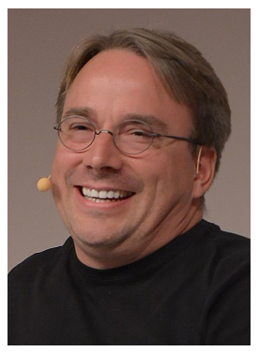
History
The Linux kernel is one component of a system, which also requires libraries and applications to provide features to end users
The Linux kernel was created as a hobby in 1991 by a Finnish student, Linus Torvalds
Linux quickly started to be used as the kernel for free software operating systems
Linus Torvalds has been able to create a large and dynamic developer and user community around Linux
Nowadays, more than one thousand people contribute to each kernel release, individuals or companies big and small.

Slide 3
Linux kernel key features
Portability and hardware support. Runs on most architectures (see arch/ in the source code).
Scalability. Can run on super computers as well as on tiny devices (4 MB of RAM is enough).
Compliance to standards and interoperability.
Exhaustive networking support.
Security. It can’t hide its flaws. Its code is reviewed by many experts.
Stability and reliability.
Modularity. Can include only what a system needs even at run time.
Easy to program. You can learn from existing code. Many useful resources on the net.

Slide 4
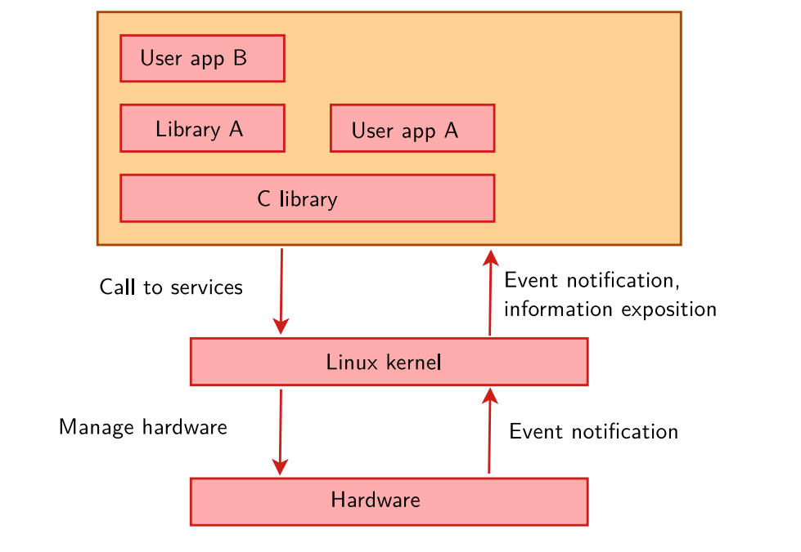
Linux kernel in the system

Slide 5
Linux kernel main roles
Manage all the hardware resources: CPU, memory, I/O.
Provide a set of portable, architecture and hardware independent APIs to allow user space applications and libraries to use the hardware resources.
Handle concurrent accesses and usage of hardware resources from different applications.
Example: a single network interface is used by multiple user space applications through various network connections. The kernel is responsible for “multiplexing” the hardware resource.

Slide 6
System calls
The main interface between the kernel and user space is the set of system calls
About 400 system calls that provide the main kernel services
File and device operations, networking operations, inter-process communication, process management, memory mapping, timers, threads, synchronization primitives, etc.
This interface is stable over time: only new system calls can be added by the kernel developers
This system call interface is wrapped by the C library, and user space applications usually never make a system call directly but rather use the corresponding C library function

Slide 7
Pseudo filesystems
Linux makes system and kernel information available in user space through pseudo filesystems, sometimes also called virtual filesystems
Pseudo filesystems allow applications to see directories and files that do not exist on any real storage: they are created and updated on the fly by the kernel
The two most important pseudo filesystems are
proc, usually mounted on /proc: Operating system related information (processes, memory management parameters...)
sysfs, usually mounted on /sys: Representation of the system as a tree of devices connected by buses. Information gathered by the kernel frameworks managing these devices.

Slide 8
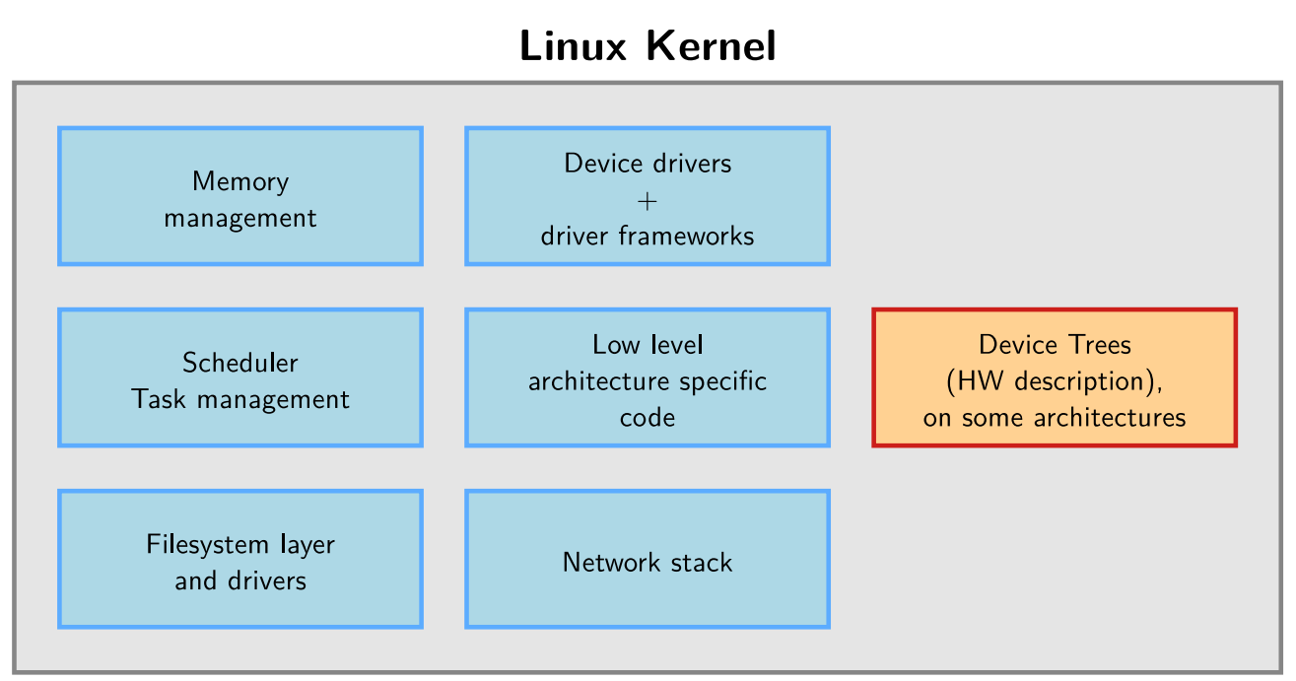
Inside the Linux kernel

Slide 9
The Linux kernel
Embedded Linux kernel usage

Slide 10
Linux Sources
The official (mainline) versions of the Linux kernel, as released by Linus Torvalds, are available at https://kernel.org
These versions follow the development model of the kernel
However, they may not contain the latest development from a specific area yet. Some features in development might not be ready for mainline inclusion yet.
Many chip vendors supply their own kernel sources
Focusing on hardware support first
Can have a very important delta with mainline Linux
Useful only when mainline hasn’t caught up yet. Many vendors invest in the mainline kernel at the same time.
Many kernel sub-communities maintain their own kernel, with usually newer but fewer stable features
Architecture communities (ARM, MIPS, PowerPC, etc.), device drivers communities (I2C, SPI, USB, PCI, network, etc.), other communities (real-time, etc.)
No official releases, only meant for sharing work and contributing to the mainline version.

Slide 11
Location of kernel sources
The kernel sources are available from https://kernel.org/pub/linux/kernel as full tarballs (complete kernel sources) and patches (differences between two kernel versions).
However, more and more people use the git version control system. Absolutely needed for kernel development!
Fetch the entire kernel sources and history
git clone https://git.kernel.org/pub/scm/linux/kernel/git/torvalds/linux
Create a branch that starts at a specific stable version
git checkout -b v5.6
Web interface available at
https://git.kernel.org/cgit/linux/kernel/git/torvalds/linux.git/tree/
Read more about Git at https://git-scm.com/

Slide 12
Linux kernel size
Linux 5.10.11 sources:
70,639 files (git ls-files | wc -l)
29,746,102 lines (git ls-files | xargs cat | wc -l)
962,810,769 bytes (git ls-files | xargs cat | wc -c)
A minimum uncompressed Linux kernel just sizes 1-2 MB
Why are these sources so big?
Because they include thousands of device drivers, many network protocols, support many architectures and filesystems...
The Linux core (scheduler, memory management...) is pretty small!

Slide 13
Linux kernel size
As of kernel version 5.7 (in percentage of total number of lines)
drivers/: 60.1%
arch/: 12.9%
fs/: 4.7%
sound/: 4.2%
net/: 4.0%
include/: 3.6%
tools/: 3.2%
Documentation/: 3.2%
kernel/: 1.3%
lib/: 0.6%
mm/: 0.5%
scripts/: 0.4%
crypto/: 0.4%
security/: 0.3%
block/: 0.2%
samples/: 0.1%
virt/: 0.1%
...

Slide 14
Programming language
Implemented in C like all UNIX systems, no C++
See http://vger.kernel.org/lkml/#s15-3
A little Assembly is used too:
CPU and machine initialization, exceptions
Critical library routines
All the code compiled with gcc
Many gcc specific extensions used in the kernel code, any ANSI C compiler will not compile the kernel
See https://gcc.gnu.org/onlinedocs/gcc-10.2.0/gcc/C-Extensions.html
Ongoing efforts to use different compilers and programming languages
LLVM C compiler (Clang) - https://clangbuiltlinux.github.io/
Rust - https://lwn.net/Articles/829858/

Slide 15
No C library
The kernel has to be standalone and can’t use user space code
Architectural reason: user space is implemented on top of kernel services, not the opposite.
Hence, kernel code has to supply its own library implementations (string utilities, cryptography, uncompression...)
So, you can’t use standard C library functions in kernel code (printf(), memset(), malloc(),...).
Fortunately, the kernel provides similar C functions for your convenience, like printk(), memset(), kmalloc(), ...

Slide 16
Portability
The Linux kernel code is designed to be portable
All code outside arch/ should be portable
To this aim, the kernel provides macros and functions to abstract the architecture specific details
Endianess
cpu_to_be32()
cpu_to_le32()
be32_to_cpu()
le32_to_cpu()
I/O memory Access
Memory barriers to provide ordering guarantees if needed
DMA API to flush and invalidate caches if needed
Never use floating point numbers in kernel code. Your code may need to run on a low-end processor without a floating point unit.

Slide 17
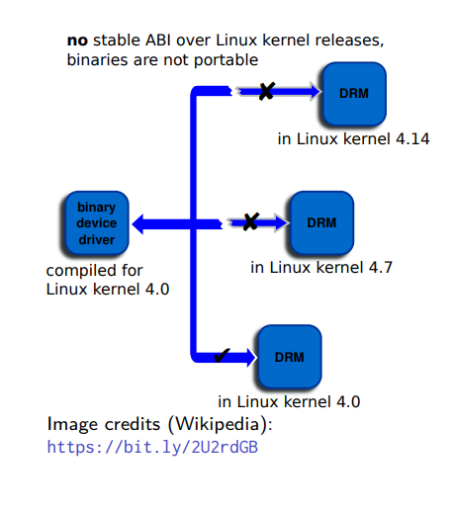
No stable Linux internal API
The internal kernel API to implement kernel code can undergo changes between two releases.
In-tree drivers are updated by the developer proposing the API change: works great for mainline code.
An out-of-tree driver compiled for a given version may no longer compile or work on a more recent one.
See process/stable-api-nonsense in kernel documentation for reasons why
Of course, the kernel to user space API does not change (system calls, /proc, /sys), as it would break existing programs.

Slide 18
Kernel memory constraints
No memory protection
The kernel doesn’t try to recover from attemps to access illegal memory locations. It just dumps oops messages on the system console.
Fixed size stack (8 or 4 KB). Unlike in user space, no mechanism was implemented to make it grow. Don’t use recursion!

Slide 19
Linux kernel licensing constraints
The Linux kernel is licensed under the GNU General Public License version 2
This license gives you the right to use, study, modify and share the software freely
However, when the software is redistributed, either modified or unmodified, the GPL requires that you redistribute the software under the same license, with the source code
If modifications are made to the Linux kernel (for example to adapt it to your hardware), it is a derivative work of the kernel, and therefore must be released under GPLv2
However, you’re only required to do so
At the time the device starts to be distributed
To your customers, not to the entire world

Slide 20
Proprietary code and the kernel
It is illegal to distribute a binary kernel that includes statically compiled proprietary drivers
The kernel modules are a gray area: are they derived works of the kernel or not?
There are some examples of proprietary drivers, like the Nvidia graphics drivers
They use a wrapper between the driver and the kernel
Unclear whether it makes it legal or not

Slide 21
Advantages of GPL drivers
You don’t have to write your driver from scratch. You can reuse code from similar free software drivers.
Your drivers can be freely and easily shipped by others (for example by Linux distributions or embedded Linux build systems).
Pre-compiled drivers work with only one kernel version and one specific configuration, making life difficult for users who want to change the kernel version.
Legal certainty, you are sure that a GPL driver is fine from a legal point of view.

Slide 22
Advantages of mainlining your kernel drivers
The community, reviewers and maintainers will review your code before accepting it, offering you the opportunity to enhance it and understand better the internal APIs.
Once accepted, you will get cost-free bug and security fixes, support for new features, and general improvements.
Your work will automatically follow the API changes.
Accessing your code will be much easier for users.
Your code will remain valid no matter the kernel version.
This will for sure reduce your maintenance and support work

Slide 23
User space device drivers
In some cases, it is possible to implement device drivers in user space!
Can be used when
The kernel provides a mechanism that allows user space applications to directly access the hardware.
There is no need to leverage an existing kernel subsystem such as the networking stack or filesystems.
There is no need for the kernel to act as a “multiplexer” for the device: only one application accesses the device.

Slide 24
User space device drivers
Possibilities for user space device drivers:
USB with libusb, https://libusb.info/
SPI with spidev, spi/spidev
I2C with i2cdev, i2c/dev-interface
Memory-mapped devices with UIO, including interrupt handling,
driver-api/uio-howto
Certain classes of devices (printers, scanners, 2D/3D graphics acceleration) are typically handled partly in kernel space, partly in user space.

Slide 25
Linux sources structure
arch/<ARCH>
Architecture specific code
arch/<ARCH>/mach-<machine>, SoC family specific code
arch/<ARCH>/include/asm, architecture-specific headers
arch/<ARCH>/boot/dts, Device Tree source files, for some architectures
block/
Block layer core
certs/
Management of certificates for key signing
COPYING
Linux copying conditions (GNU GPL)
CREDITS
Linux main contributors

Slide 26
Linux sources structure
crypto/
Cryptographic libraries
Documentation/
Kernel documentation sources
Generated documentation available on https://kernel.org/doc/
(includes functions prototypes and comments extracted from source code).
drivers/
All device drivers except sound ones (usb, pci...)
fs/
Filesystems (fs/ext4/, etc.)
include/
Kernel headers
include/linux/
Linux kernel core headers

Slide 27
Linux sources structure
include/uapi/
User space API headers
init/
Linux initialization (including init/main.c)
ipc/
Code used for Inter Process Communication
Kbuild
Part of the kernel build system
Kconfig
Top level description file for configuration parameters
kernel/
Linux kernel core (very small!)
lib/
Misc library routines (zlib, crc32...)

Slide 28
Linux sources structure
MAINTAINERS
Maintainers of each kernel part. Very useful!
Makefile
Top Linux Makefile (sets version information)
mm/
Memory management code (small too!)
net/
Network support code (not drivers)
README
Description of kernel documentation
samples/
Sample code (markers, kprobes, kobjects, bpf...)

Slide 29
Linux sources structure
scripts/
Executables for kernel building and debugging
security/
Security model implementations (SELinux...)
sound/
Sound support code and drivers
tools/
Code for various user space tools (mostly C, example: perf)
usr/
Code to generate an initramfs cpio archive
virt/
Virtualization support (KVM)

